Slide 1
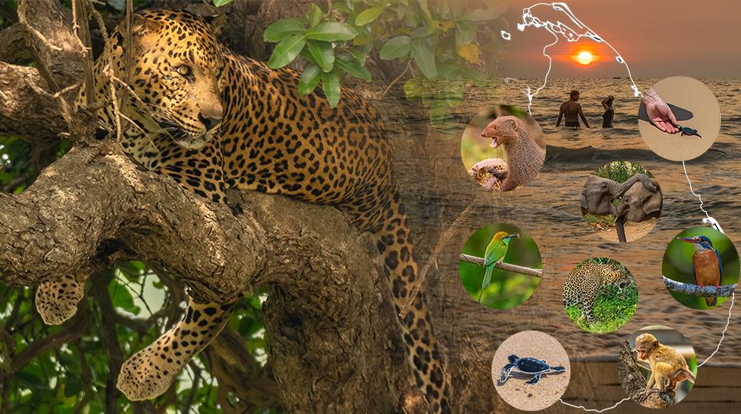
Welcome
Analysing photography holidays in Sri Lanka
Roshan, Yvonne & Godswill]
Data Analytics

Slide 2
Agenda
List the main areas you will cover in your project presentation.
Selecting Sri Lanka for this project.
Problem statement
Hypothesis
Data and tools used and repurposing publicly available dataset for the project.
Exploratory analysis in Sri Lankan tourisms
Photography holiday activities during the visit
Identify visited locations
Key stakeholders (e.g., tour operators, photographers, conservation organizations)
Overview of wildlife species

Slide 3
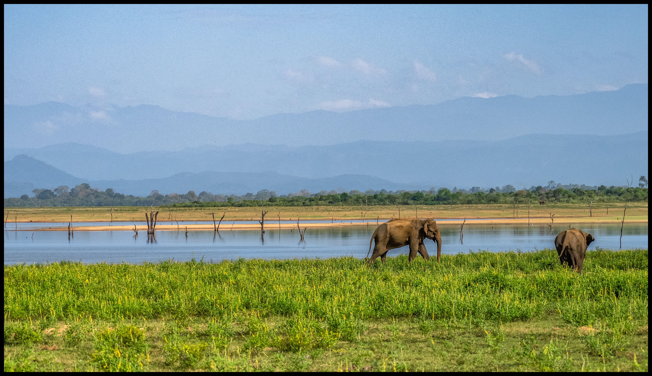
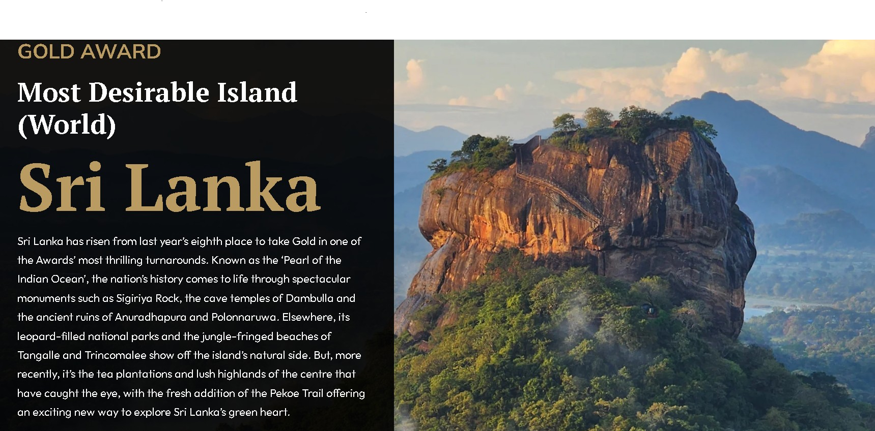
Selecting Sri Lanka for this project.
Sri Lanka ranked 9th best destination to travel in 2025 in BBC’s first-ever travel guide
https://www.bbc.com/travel/article/20250115-the-25-best-places-to-travel-in-2025
Sri Lanka won the Wanderlust Reader Gold Award for “Most Desirable Island to Visit” in 2024.
https://www.wanderlustmagazine.com/inspiration/wanderlust-travel-awards-2024-the-results

Slide 4
The Problem Statement
Is there significant demand for photography holidays in Sri Lanka?
To determine the level of demand for photography holidays in Sri Lanka, the related activities they engage in, the locations they prefer to visit during their trips, and to identify frequent travellers.

Slide 5
Hypothesis
Discuss the Hypothesis you have for the solution and what is fuelling this hypothesis. If there is no such hypothesis, then why not?
There is a significant demand for photography holidays in Sri Lanka. Travellers who choose these holidays tend to engage in specific related activities, visit particular locations that are popular for photography, and a substantial portion of these travellers are repeat visitors.
Did you come across any previous problems similar to yours and what were the solutions to these similar problems?

Slide 6
Data and Tools Used
Where did you find the dataset?
Publicly available Tourism and Travel Review: Sri Lankan Destinations dataset
Did you have to join multiple datasets in order to create the ideal dataset?
Created a MySQL database based on source data, creating individual tables to process and analyse using SQL and Python.
What other data would you have liked to have in an ideal scenario?
Vacation type. How may days spend in a one location and participated list of activities.
Which tools did you use to undertake the processing and statistical analysis?
Used Tableau Desktop data visualisation

Slide 7
Data Processing
What did you do to refine your data: outline your process.
Outliers. How did you determine outliers in your dataset? What thresholds did you set? Did you have to make any additional assumptions?

Slide 8
Data Processing
What did you do to refine your data: outline your process.
Outliers. How did you determine outliers in your dataset? What thresholds did you set? Did you have to make any additional assumptions?

Slide 9
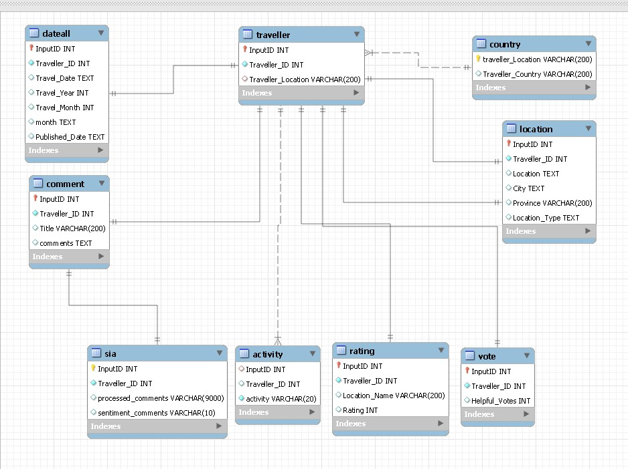


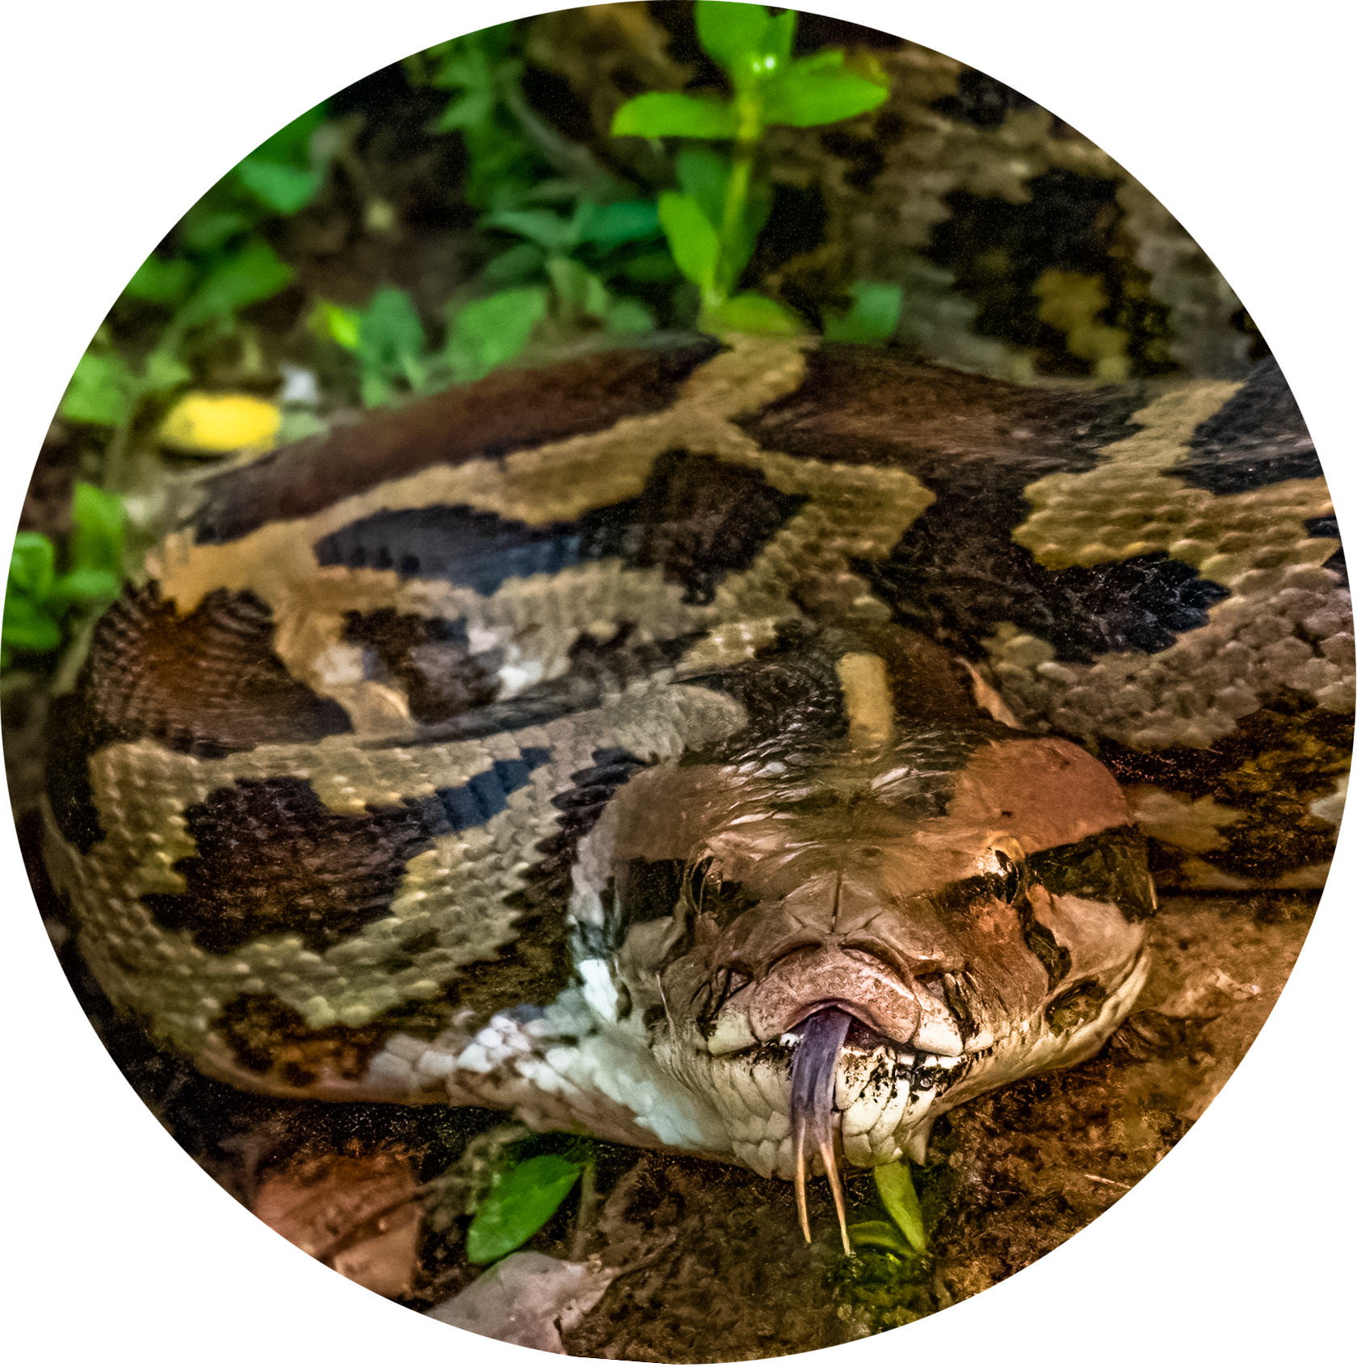

Data Processing
ETL
Reviews.CSV
Country Mapper
Data extraction
for QC
Sentiment analysis

Slide 10
Data Processing
Were there any surprising insights from your data processing/exploration?
Plots showing these insights? These can be visuals exported from Tableau.

Slide 11
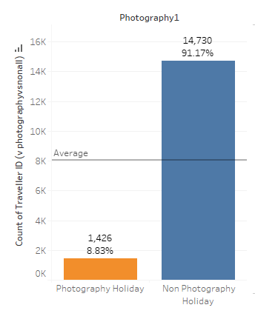
Statistical Analysis
An overview of the different statistical analyses performed, and why they were chosen.
Note: Feel free to make multiple slides to discuss each one in more detail.
T-test
statistic=-2.621575989760646,
pvalue=0.008760628117346781,
df=16154.0
Z-test
-2.621575989760646
0.008752424774515799
The low p-value(0.00876) implies that the observed feedback rate of 8.83% from 16,156 foreign visitors is statistically significant. This supports the idea that there is a real interest in photography services among holiday visitors to Sri Lanka.

Slide 12
Insights Discussion
What were the main insights from the Statistical Analyses
Note: Using visuals to discuss these would be ideal. These can be visuals exported from Tableau

Slide 13
Summary Conclusions
Was your expected Hypothesis confirmed or not?
Did the problem get solved from your analysis?
If not, then where do you think the issue happened.
Note: A Hypothesis not getting confirmed is not a failure. It is a scientific method of improving understanding. Be comfortable with negative results as they are just as important in informing decisions!

Slide 14
Key Learnings
What would you change in this project process if you could do this all over again?

Slide 15
Thank You

Slide 16
Appendix

Slide 17
References
References for the entire workflow can go here or in Speaker Notes per slide.

